Slide 1
CREC Museum Academy Explorers Physical Education
Exploring Physical Education
Next

Slide 2
Quality Physical Education
helps all students develop:
health-related fitness,
physical competence,
cognitive understanding,
positive attitudes about physical activity
Next

Slide 3
Museum academy physical education
School
Teacher
Community
Resources
Click a link to learn more….

Slide 4
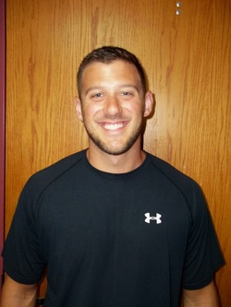
The Teacher
I received my undergraduate degree in PE from CCSU
I am currently working on my graduate degree in PE at CCSU
Next

Slide 5
Teacher Continued
I believe that by providing a combination of teaching styles and activities students of all abilities will have the greatest chance to learn.
Next

Slide 6
The Teacher Continued
My professional goal
is increase my students fitness levels as well as their knowledge of fitness concepts.
In my free time I enjoy to be active, play sports, work out, etc.
Museum
Academy

Slide 7
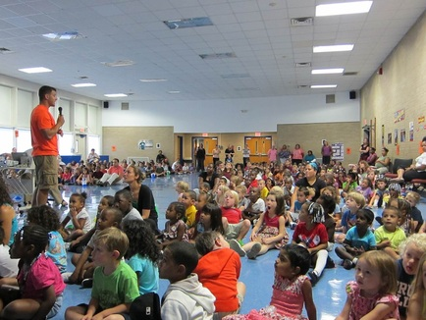
Crec museum academy
Museum themed elementary school
Located in Bloomfield, CT
Next

Slide 8
Museum Theme
Exhibition nights to showcase student learning and in-depth knowledge on topics taught
Student docents to welcome visitors and explain learning in our museum
Expeditions to partner museums monthly, which extends the learning outside of the classroom
Wadsworth Atheneum
The Children's Museum
The Connecticut Science Center
Connecticut Historical Society
The Bushnell
Hands-on, minds-on, authentic learning
With a focus on active learning, students in PreK-Grade 5 explore and uncover each lesson so it has greater meaning.
Classroom and school-wide projects transform the school into a living museum, with grade-level students acting as guides for exhibitions in our exhibit hall.
Next

Slide 9
Our Physical Education Program
Aerobic Activities
Cooperative Games & Adventure Activities
Manipulative Skills
Invasion Games
Physical Fitness
Rhythmic Movements
Museum
Academy
Click a link to learn more….

Slide 10
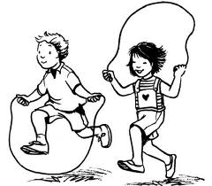
Aerobic Activities
Fun activities that are designed to raise a students heart rate
Tag games, dance, jump rope, aerobics (some rhythmic activities)
PE
Program

Slide 11
Rhythmic Movements
Locomotor Movements
Skipping, galloping, jumping, hopping, running, sliding, walking
Creative Dance
Spatial Awareness
PE
Program

Slide 12
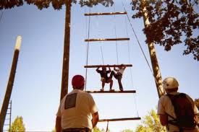
Cooperative Games & Adventure Activities
These activities are designed to help students develop leadership, interpersonal relationships, trust, as well as push themselves occupationally outside of their comfort zones.
PE
Program

Slide 13
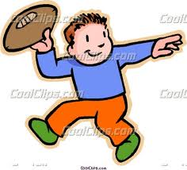
Manipulative Skills
Basic Skills
Throwing, catching, dribbling, kicking, striking
Advanced Skills (sport specific)
Baseball, football, basketball,
soccer, handball, etc.
PE
Program

Slide 14
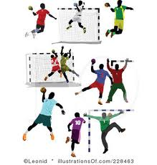
Invasion Games
Handball, Soccer, Basketball, Pillo Polo
Positions, spacing, moving with or without the “ball”
Strategies
PE
Program

Slide 15
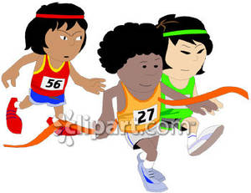
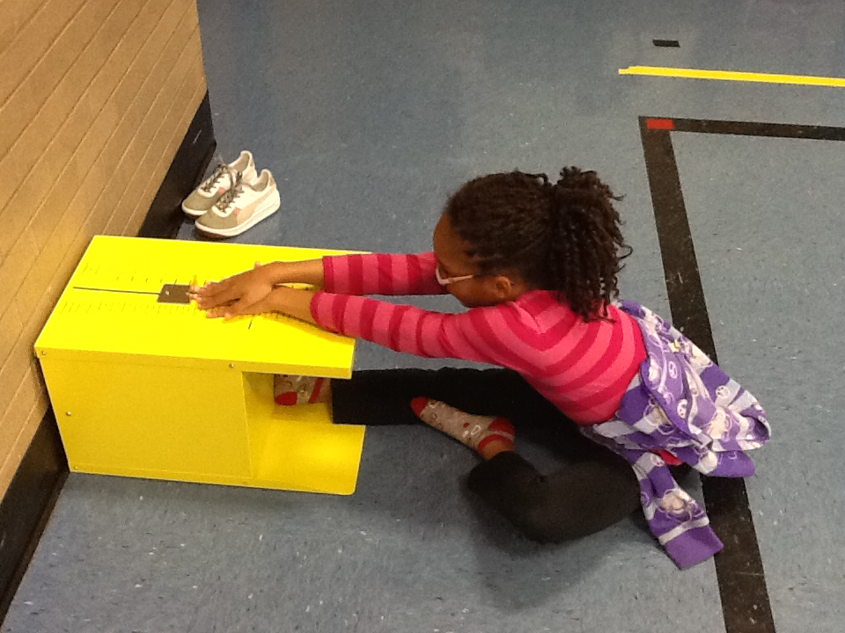
Physical Fitness
Pushups, Curlups, Sit & Reach, PACER
PE
Program

Slide 16
A.C.E.S. day
All students and staff participate
Stands for
All
Children
Exercise
Simultaneously
Next

Slide 17
Field Day
The last Friday in May
Brings together students, staff, and community
Involves activities that culminate what students have learned throughout the year
Next

Slide 18
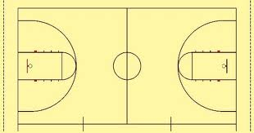
Open Gym
Allows for students to participate in extra physical activity
Every Thursday 3:15 – 4:30pm.
Basketball, Soccer, Jump Rope, Hula Hoops, etc.
Next

Slide 19
PE webpage
http://museumpe.weebly.com
Museum
Academy

Slide 20
resources
http://www.aahperd.org/
http://www.choosemyplate.gov/
http://kidshealth.org/
http://www.crossfitkids.com/
Museum
Academy

